Slide 1
PhoneBook Manager
a C language implementation.

Slide 2
Index
Introduction.
Aim of the Project.
Advantage & Disadvantage.
Hardware & Software.
Modules.
Example of Implementation.

Slide 3
Introduction
Phonebook is a very simple mini project in C that can help you understand the basic concepts of functions, file handling and data structure. This application will teach you how to add, list, modify or edit, search and delete data to/from the file.
Adding new records, listing them, modifying them and updating, search for contacts saved, and deleting the phonebook records are the basic functions which make up the main menu of this Phonebook application.

Slide 4
Personal information such as name, gender, phone number, email and address are asked while adding a record into the Phonebook. These records can then be modified, listed, searched for and removed.
…

Slide 5
Aim of this Project
To develop an “Phonebook contact” application using C programming.
This program is very useful now-a-days to store complete information under single contact number.
This program also has options to deletion and modification of the entered contact number.
To develop an “Phonebook contact” application using only C programming.

Slide 6
Advantage & Disadvantage
It becomes easy for the user to store complete information( i.e e-mail id, address) about his contact
It is easy for the user to just search his required contact number by just typing name of the contact.
Some times it becomes difficult to store more contacts(i.e over 150)
It becomes even difficult to store contacts with two or more contact numbers.

Slide 7
Hardware & Software
A well shaped computer and GNU C compiler for compiling the code. Such as,
Turbo C++
Dev C++
Code::Blocks
This application size is

Slide 8
Modules
The present program consists of the following modules:
Preprocessor commands.
Structures.
Functions.
Variables.
Statements & Expressions.

Slide 9
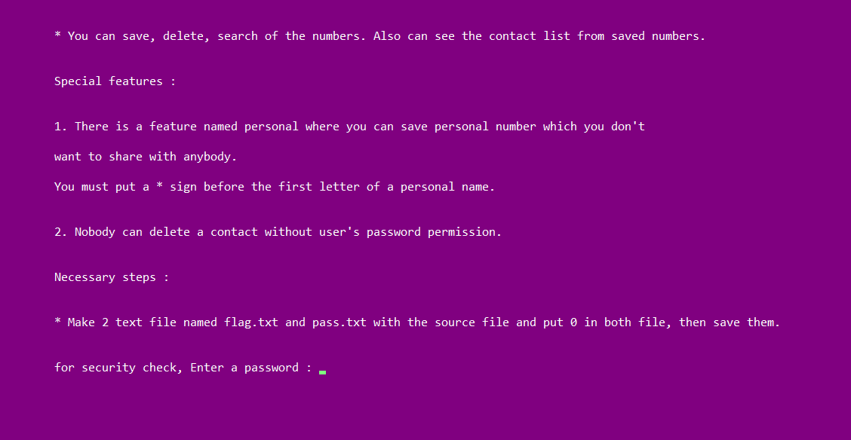
Example of Implementation
Home screen and follows:

Slide 10
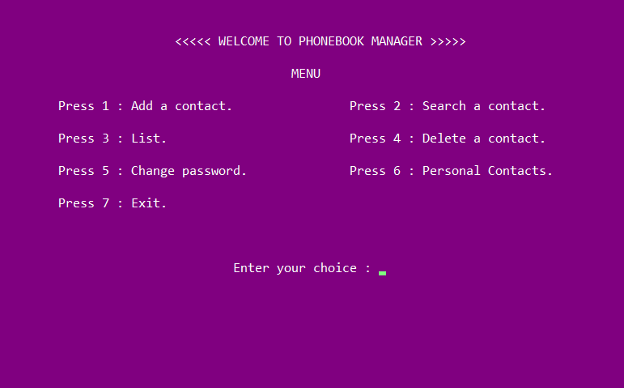
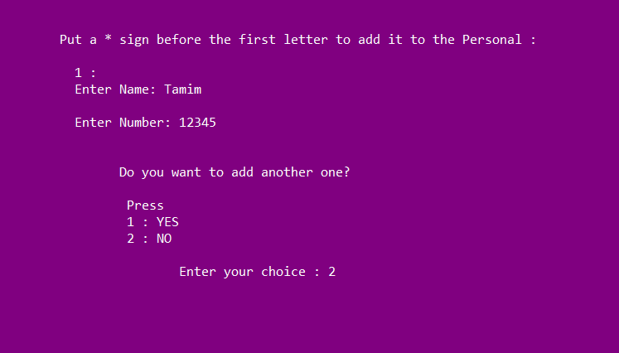
Implementation

Slide 11
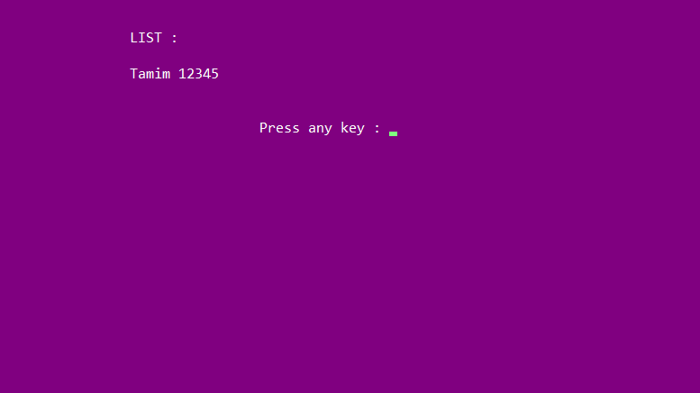
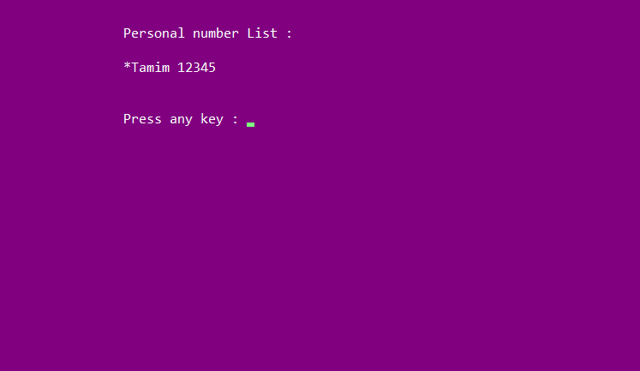
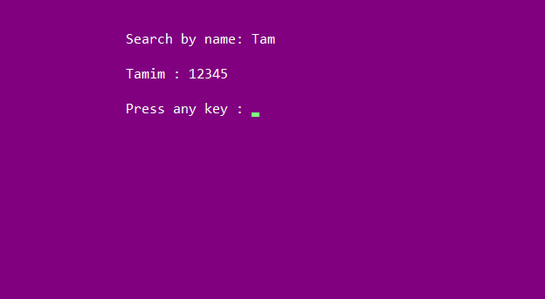

Slide 12
Submitted by,
16172103252 : Sirajum Munir Tamim
16172103253 : Maruf Ahmed Rahad
16172103258 : Md. Rabiul Hasan Emon
16172103264 : Kamrun Nahar
16172103268 : Israt Jahan
16172103269 : Fatema - Tuz – Zohora

Slide 13


